Slide 1
Cancer Mortality and Stroke Prediction
Preliminary Machine Learning Findings and Recommended Use Case
Allen Gao
Notes:
Hello, my name is Allen Gao. This presentation summarizes a preliminary machine-learning analysis conducted for a Boston healthcare company working with a local hospital. The objective was to evaluate two potential healthcare use cases: predicting community-level cancer mortality rates and predicting whether an individual experienced a stroke.
Because these targets required different analytical approaches, three regression models were evaluated for cancer, while two classification models were evaluated for stroke. I will briefly explain the data preparation, compare the models’ performance, discuss the most influential measured predictors, and conclude by recommending which use case the company should pursue first.
Before reviewing the models, it is important to understand why cancer and stroke were selected for this analysis.

Slide 2
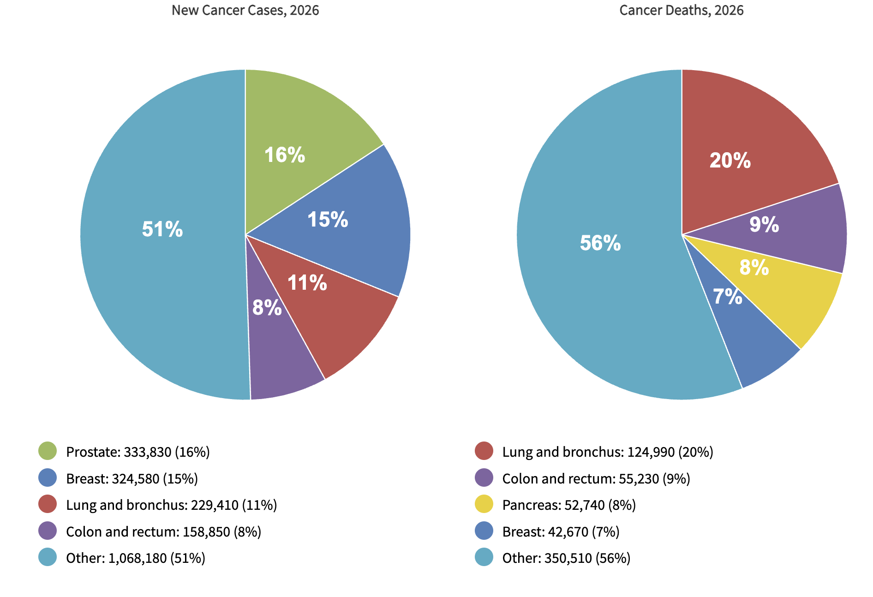
Cancer Remains a Major U.S. Health Burden
Source: American Cancer Society, Cancer Facts & Figures 2026.
Notes:
Before discussing the models, it is important to understand why these two use cases matter. First, cancer remains a major health concern in the United States. The American Cancer Society projects approximately 2.1 million new cancer diagnoses and 626,140 cancer deaths in 2026. As shown in the pie charts, cancer includes many different types. Prostate and breast cancer represent the largest shares of projected new cases shown, while lung and bronchus cancer account for the largest named share of projected deaths in the right pie. This diversity demonstrates the complexity of cancer mortality and the importance of improving prevention, screening, and healthcare-resource planning.

Slide 3
Stroke is Also Major US Health Burden
Source: CDC, Stroke Facts
Notes:
Stroke is another major health concern in the United States. Each year, more than 795,000 people experience a stroke. As shown in the graph to the right, approximately 610,000 are first or new strokes, while about 185,000 occur among people who have previously experienced a stroke. Furthermore, approximately 87% of strokes are ischemic strokes, which occur when blood flow to the brain is blocked, which could be fatal enough to kill or disable people. These figures demonstrate the importance of stroke prevention, early intervention, and identifying individuals who may have an elevated risk. Together, the substantial health burdens associated with cancer and stroke explain why these two prediction use cases were selected for this preliminary analysis.

Slide 4
Cancer Regression Performance Comparison
Models | Training Accuracy | Testing Accuracy | Accuracy Gap | Testing MAE | Testing RMSE | Computation Time (sec)
OLS Linear Regression | 52.08% | 46.56% | 5.52% | 15.64 | 20.85 | .040
Gradient Boosting | 66.58% | 48.18% | 18.40% | 15.28 | 20.53 | 1.31
MLP Regressor | 56.00% | 45.84% | 10.16% | 15.48 | 20.99 | .32
Notes:
To begin with the Cancer dataset, three cancer regression models were evaluated using the training and testing data. The Gradient produced the highest testing accuracy/R^2 of .482 and the lowest MAE and RMSE, at 15.28 and 20.53 deaths per 100,000 people. However, it also produced the largest training-testing accuracy/R^2 gap of .184, which indicates overfitting. OLS was more consistent but slightly less accurate, while the MLP Regressor produced the lowest testing R². Because all computation times were under two seconds, predictive performance was more important than speed. Overall, Gradient Boosting was selected as the strongest preliminary cancer model despite the overfitting.

Slide 5
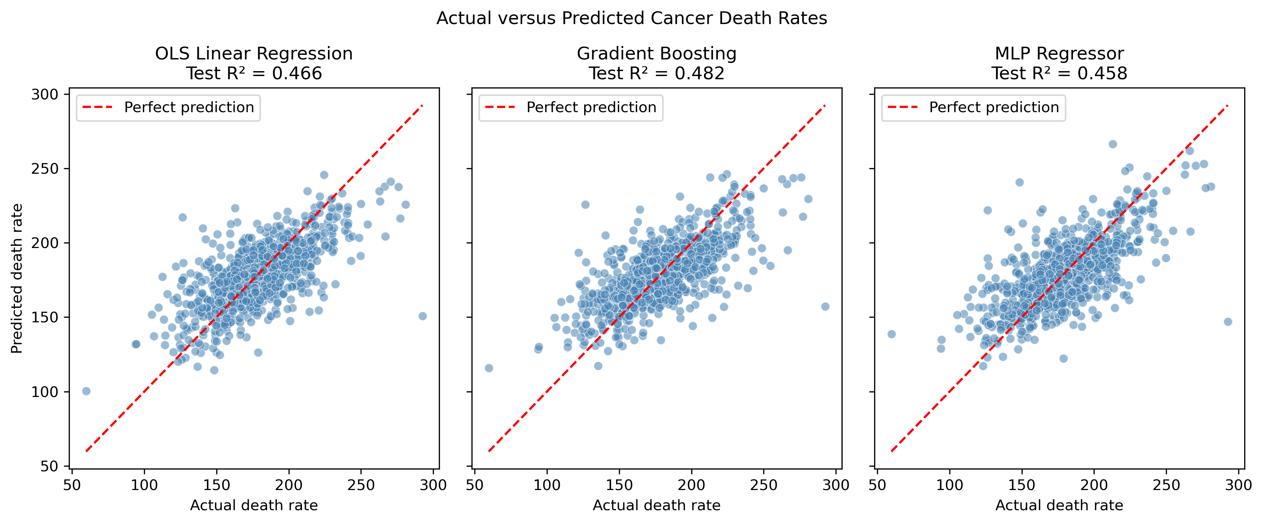
Cancer Models Captured the Trend but Missed the Extremes
Notes:
To visualize the models’ moderate testing accuracy/R^2 scores, this figure compares the actual cancer mortality rates with the rates predicted by each model. That dashed red line represents a perfect prediction. As you can see, each dot represents one community in the testing data. Points closer to the line indicate more accurate predictions, while points farther away represent larger errors. Although the observations generally follow the direction of the perfect-prediction line, considerable dispersion remains around it. As explained earlier, Gradient achieved the highest R^2/accuracy, but its advantage over the other models was relatively small. As you can see, some dots are slightly closer to the dashed line compared to the rest of the models.

Slide 6
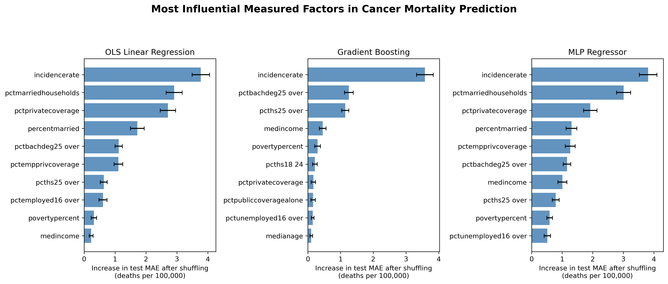
Cancer Incidence Rate was the most influential factor
Notes:
To check which factors had the greatest influence on the cancer predictions, Permutation importance was used to determine that. It is done by shuffling each predictor in the testing data, and a larger increase in MAE indicated that the model relied more heavily on that predictor. The horizontal bars show the average increase in testing MAE, while the black error bars show the variation across repeated shuffles. Cancer incidence rate was by far the most influential factor and ranked first across all three models. Education attainment, the percentage of married households, insurance coverage, median income, and poverty also influence prediction, although their relative importance varied across models. However, aside from incidence rate, most predictors produced comparatively small increases in MAE when shuffled. This suggests that the dataset contained limited predictive information beyond incidence rate, which may partly explain the models’ moderate testing R² scores. Adding more direct clinical factors—such as cancer type, stage at diagnosis, screening history, and treatment received—could potentially improve future models. These importance results indicate predictive influence, not causation.

Slide 7
High accuracy Hid Low Stroke Recall
Model | Testing Accuracy | Accuracy Gap | No-Stroke Precision | No-Stroke Recall | Stroke Precision | Stroke Recall
Logistic Regression | 95.24% | .16% | 95.3% | 99.9% | 75% | 4%
MLP Classifier | 95.24% | .10% | 95.2% | 100% | 100% | 2.7%
Notes:
Having reviewed the cancer models, I will now turn to the stroke results, which presented a different challenge because the target was highly imbalanced. At first glance, both models appear successful because they achieved about 95% testing accuracy and a low accuracy gap between the training and Testing accuracy. Both models achieved nearly 100% recall for no-stroke observations, but Logistic Regression identified only 4% of actual stroke cases, while the MLP Classifier identified approximately 2.7%. The high stroke precision values are misleading because the models made very few positive stroke predictions. Logistic Regression correctly identified only 3 of the 75 actual stroke cases, while the MLP identified only 2. Therefore, the high overall accuracy was primarily driven by the much larger no-stroke class. Logistic Regression was the better preliminary model because it achieved slightly higher stroke recall and F1-score, but neither model could reliably identify strokes.

Slide 8
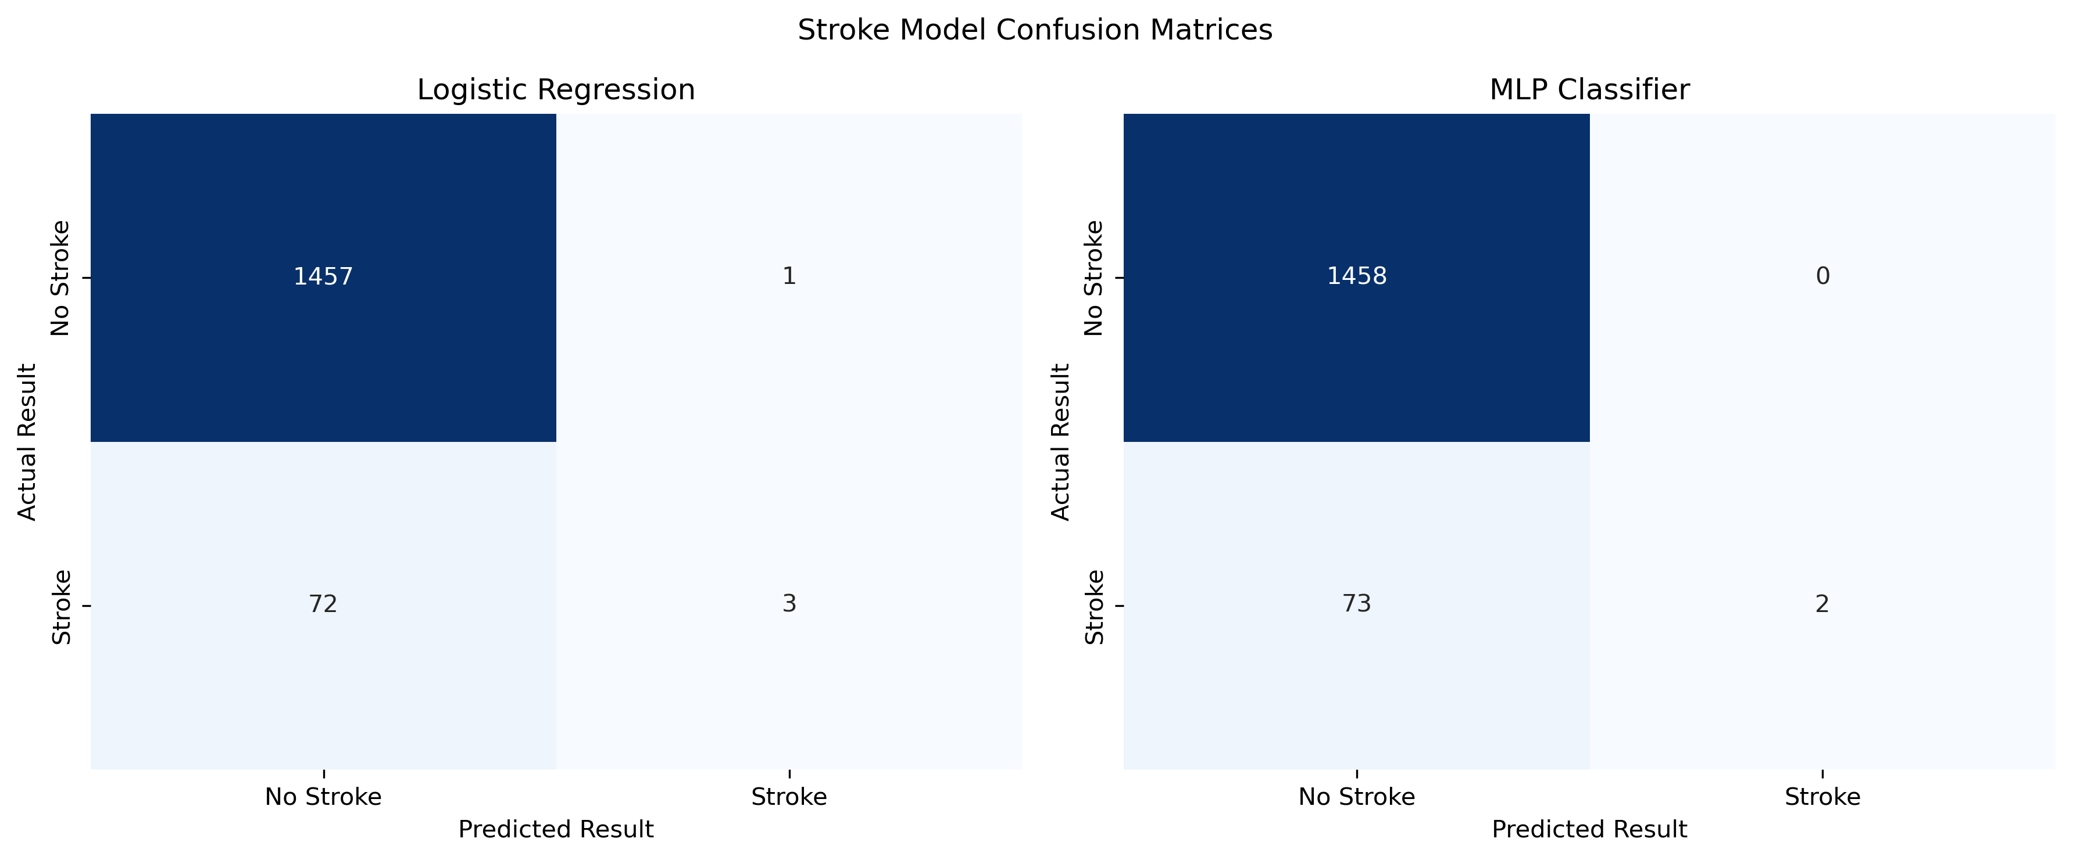
The Confusion Matrices of Stroke Model
Notes:
As seen here, these Confusion Matrices make the weakness behind the high accuracy scores more visible. The rows represent the patients’ actual outcomes, while the columns represent the outcomes predicted by each model using the selected .39 threshold. Logistic Regression correctly classified 1,457 no-stroke cases and three stroke cases. However, it missed 72 of the 75 actual stroke cases and incorrectly classified one no-stroke case as a stroke. The MLP Classifier correctly classified all 1,458 no-stroke cases but identified only two actual strokes and missed the remaining 73. Therefore, both models overwhelmingly predicted the majority no-stroke class. For a stroke-risk identification tool, these false negatives are particularly concerning because individuals with elevated risk could be overlooked. Logistic Regression performed marginally better, but neither model is currently reliable enough for clinical use.

Slide 9
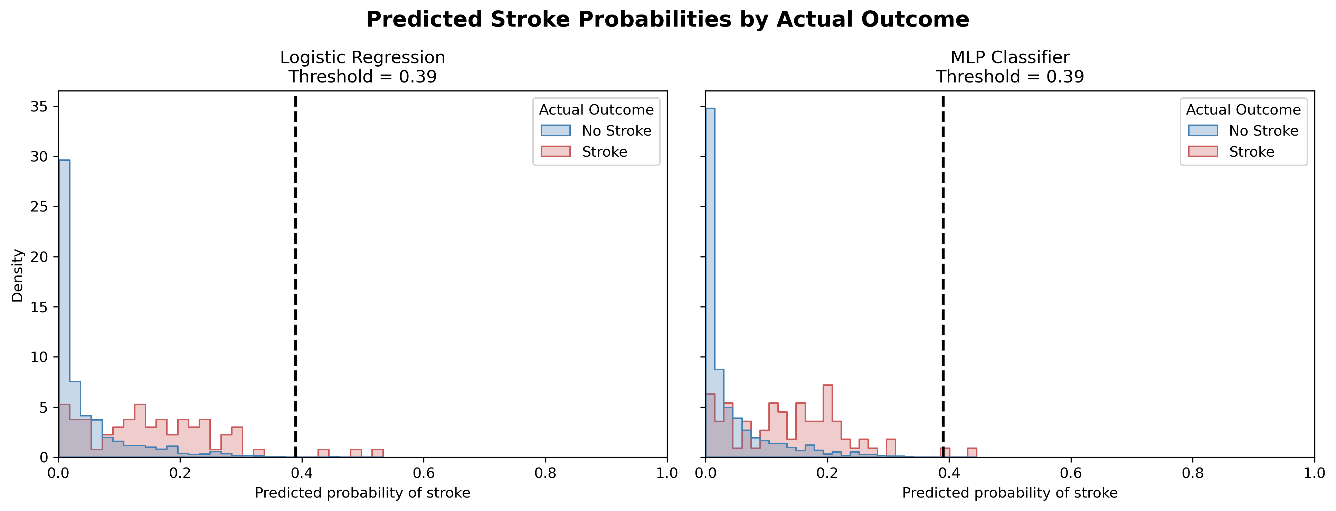
Missed Strokes due to Probability Overlap
Notes:
To understand why both models missed most actual stroke cases, this figure compares their predicted stroke probabilities by actual outcome. The horizontal axis represents the probability assigned to stroke, while blue represents patients who did not experience a stroke and red represents patients who did. The dashed line marks the selected classification threshold of .39, meaning that only observations at or above this line were classified as strokes. Actual stroke cases generally received somewhat higher probabilities than no-stroke cases, but the two distributions overlapped substantially. Most actual stroke cases remained below the threshold and were therefore classified as no stroke. Only a few crossed the threshold, which is consistent with Logistic Regression identifying three strokes and the MLP identifying two. Lowering the threshold could identify additional stroke cases, but it would also increase false-positive predictions. Therefore, the threshold should ultimately reflect the relative consequences of missing a stroke-risk case versus producing a false warning.

Slide 10
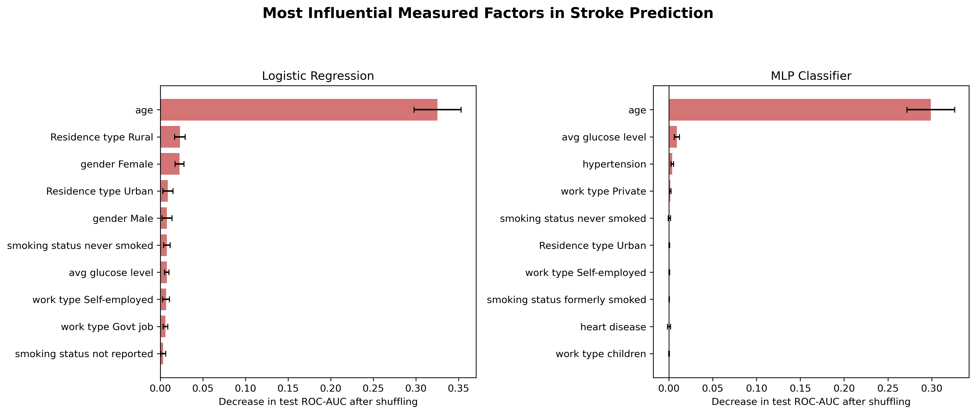
Age Dominated Stroke Prediction in Both Models
Notes:
To determine which measured factors most influenced the stroke predictions, permutation importance was applied using ROC-AUC as the scoring metric. Each predictor was repeatedly shuffled in the testing data, and the resulting decrease in ROC-AUC was measured. A larger decrease indicates that the model relied more heavily on that predictor when distinguishing stroke from no-stroke observations. Age was by far the most influential measured factor for both Logistic Regression and the MLP Classifier, producing a decrease of approximately .30 or more in testing ROC-AUC when shuffled. The remaining predictors had substantially smaller and less consistent importance values. Average glucose level and hypertension provided some additional information for the MLP, while residence type and gender contributed slightly more to Logistic Regression. Such heavy dependence on a single predictor is a limitation because stroke risk cannot be fully represented by age alone. It would have been preferable to have more actual stroke cases and more detailed clinical information so that the models could potentially learn a broader and more reliable combination of risk patterns.

Slide 11
Recommendation: Pursue the Cancer Use Case First
Cancer: Testing Accuracy/R^2 = 48.2%, MAE = 15.28 deaths per 100,000
Stroke: 95.24% accuracy, but only 3 and 2 of 75 Strokes detected in the test dataset
In conclusion, neither model is ready to serve as a standalone clinical decision-making tool. However, the cancer model produced more meaningful and operationally useful predictions at the community level. Therefore, I recommend beginning with a limited cancer population-health planning pilot to support screening, prevention, and resource-prioritization decisions. The stroke use case should remain in development until more actual stroke cases, stronger clinical predictors, and imbalance-aware modeling methods are available.

